Slide 1
Relational Database Design

Slide 2
Relational Database Design
Features of Good Relational Design
Atomic Domains and First Normal Form
Decomposition Using Functional Dependencies
Functional Dependency Theory
Algorithms for Functional Dependencies

Slide 3
What is Normalization
Set of database design techniques to eliminate duplicate / redundancy
Normalization usually involves dividing large tables into smaller (and less redundant) tables and defining relationships between them.
These tables do not have anomalies and no lost information
A standard piece of database design guidance is that:
the designer should first create a fully normalized design; then selective denormalization can be performed for performance reasons

Slide 4
History
Edgar F. Codd, introduced normalization
First Normal Form (1NF) in 1970.
Codd defined the Second Normal Form (2NF) and Third Normal Form (3NF) in 1971
Codd and Raymond F. Boyce defined the Boyce-Codd Normal Form (BCNF) in 1974
a relational database table is often described as "normalized" if it is in the Third Normal Form.
3NF tables are free of insertion, update, and deletion anomalies.

Slide 5
Database Normalization
The main goal of Database Normalization is to restructure the logical data model of a database to:
Eliminate redundancy
Organize data efficiently
Reduce the potential for data anomalies
Data anomalies are inconsistencies in the data stored in a database as a result of an operation such as update, insertion, and/or deletion.
Such inconsistencies may arise when have a particular record stored in multiple locations and not all of the copies are updated.
One of the key requirements to remember is that Normal Forms are progressive. That is, in order to have 3rd NF we must have 2nd NF and in order to have 2nd NF we must have 1st NF.

Slide 6
anomalies
An anomaly is an irregularity, or something which deviates from the expected or normal state
An insertion anomaly is the inability to add data to the database due to absence of other data
For example, assume Employee_Group is defined so that null values are not allowed. If a new employee is hired but not immediately assigned to a Employee_Group then this employee could not be entered into the database. This results in database inconsistencies due to omission.
A deletion anomaly is the unintended loss of data due to deletion of other data
For example, if the Employee_Group dBeta Alpha Psi disbanded and was deleted from the table below, J. Longfellow and the Accounting department would cease to exist due cascading on delete.
An update anomaly is a data inconsistency that results from data redundancy and a partial update
Marketing department is listed twice and any update must be done twice as well.
Employee ID | Name | Department | Employee Group
143 | Sambu | ssds | dsds
123 | J. Longfellow | Accounting | dBeta Alpha Psi
234 | B. Rech | Marketing | Marketing Club
345 | B. Rech | Marketing | Management Club
456 | A. Bruchs | CIS | Technology Org.
567 | A. Bruchs | CIS | Beta Alpha Psi

Slide 7
1st Normal Form

Slide 8
1st Normal Form
A table is in 1st Normal Form if:
There are no repeating columns (repeating groups)
two columns do not store similar information in the same table.
All data values are atomic
Can’t be broken down any further
(No multi-value attributes allowed)
Each field has a unique name
It has a primary key

Slide 9
1st Normal Form
No Repeating Groups
Person table
Can we add another person with no children?
Can we add another person with 4 children?
Id | name | email | Address | child1 | child2 | child3
100 | Omar Aldawud | omar@omar.com | 22 East State St | Jordan | Hannah | Noah
200 | Tom Hernandez | tom@tom.com | 78 North 33rd st. | Mark | John | null

Slide 10
1st Normal Form
No Repeating Groups
Split Table (make a table for the repeating group)
Person
Dependents
Id | name | email | phone | Address
100 | Omar Aldawud | omar@omar.com | 630-4562389 | 22 East State St
200 | Tom Hernandez | tom@tom.com | 312-4567895 | 78 North 33rd st.
Id | Child Seq No | child
100 | 1 | Jordan
100 | 2 | Hannah
100 | 3 | Noah
200 | 1 | Mark
200 | 2 | John

Slide 11
1st Normal Form
All data values are atomic
Split the columns Name and Address
Person
Dependents
Id | first name | last name | email | phone | street no | Street name
100 | Omar | Aldawud | omar@omar.com | 630-4562389 | 22 East | State St
200 | Tom | Hernandez | tom@tom.com | 312-4567895 | 78 North | 33rd Av
Id | Child Seq No | child
100 | 1 | Jordan
100 | 2 | Hannah
100 | 3 | Noah
200 | 1 | Mark
200 | 2 | John

Slide 12
1st Normal Form
Each field has a unique name
Okay
It has a primary key
Person
Dependents
id | first name | last name | email | phone | street no | Street name
100 | Omar | Aldawud | omar@omar.com | 630-4562389 | 22 East | State St
200 | Tom | Hernandez | tom@tom.com | 312-4567895 | 78 North | 33rd Av
Id | child seq No | child
100 | 1 | Jordan
100 | 2 | Hannah
100 | 3 | Noah
200 | 1 | Mark
200 | 2 | John

Slide 13
2nd Normal form

Slide 14
2nd Normal Form
A table is in 2nd Normal Form if:
Its in 1st Normal Form and
All non-key attributes are dependent on all parts of the primary key
We are only considering tables that are dependent on composite key
So any table that is in 1st normal form and does not have a composite key is also in 2nd normal form
In other words
Redundant data across multiple rows of a table must be moved to a separate table.
The resulting tables must be related to each other by use of foreign key.

Slide 15
2nd Normal Form
non-key attributes are dependent on all parts of the primary key
Person (already in 2nd normal form since the key is not composite (id))
Dependents
Non key attributes: child
In 2nd normal form since a child can only be identified with a combination of id and child seq number
id | first name | last name | email | phone | street no | Street name
100 | Omar | Aldawud | omar@omar.com | 630-4562389 | 22 East | State St
200 | Tom | Hernandez | tom@tom.com | 312-4567895 | 78 North | 33rd Av
Id | Child Seq No | child
100 | 1 | Jordan
100 | 2 | Hannah
100 | 3 | Noah
200 | 1 | Mark
200 | 2 | John

Slide 16
2nd Normal Form
Example 2
Person (already in 2nd normal form since the key is not composite (id))
Person Project table
Id | first name | last name | email | phone | street no | Street name
100 | Omar | Aldawud | omar@omar.com | 630-4562389 | 22 East | State St
200 | Tom | Hernandez | tom@tom.com | 312-4567895 | 78 North | 33rd Av
pid | proj_id | person_name | proj_code | proj_name
100 | 1 | Omar | 300 | DB design
100 | 2 | Omar | 400 | Class Diagram
100 | 3 | Omar | 500 | Code Gen
200 | 1 | Tom | 300 | DB Design
200 | 2 | Tom | 400 | Class Diagram

Slide 17
2nd Normal Form
Example
Person Project table
Table violates 2nd Normal Form
Person is dependent on Person ID only (partial key)
Project is dependent on proj_code (partial key)
pid | proj_id | person_name | proj_code | proj_name
100 | 1 | Omar | 300 | Db design
100 | 2 | Omar | 400 | Class Diagram
100 | 3 | Omar | 500 | Code Gen
200 | 1 | Tom | 300 | Db Design
200 | 2 | Tom | 400 | Class Diagram

Slide 18
2nd Normal Form
Example Person Project table
Split the table into 3 tables:
Person,
Project and
Person_Project
Person (pid, person_name)
Project (proj_id, proj_code, proj_name)
Person_Proejct (pid, proj_id)
How can I get the original table?
pid | proj_id | person_name | proj_code | proj_name
100 | 1 | Omar | 300 | Db design
100 | 2 | Omar | 400 | Class Diagram
100 | 3 | Omar | 500 | Code Gen
200 | 1 | Tom | 300 | Db Design
200 | 2 | Tom | 400 | Class Diagram

Slide 19
2nd Normal Form
Second Normal Form: Eliminate Redundant Data
Not in 2nd Normal Form
Note the multiple Class# values for each Student# value in the above table. Class# is not functionally dependent on Student# (primary key), so this relationship is not in second normal form.
Student# | Advisor | Adv-Room | Class#
1022 | Jones | 412 | 101-07
1022 | Jones | 412 | 143-01
1022 | Jones | 412 | 159-02
4123 | Smith | 216 | 201-01
4123 | Smith | 216 | 211-02
4123 | Smith | 216 | 214-01

Slide 20
2nd Normal Form
Second Normal Form: Eliminate Redundant Data
The following two tables demonstrate second normal form:
Students:
Registration:
Student# | Advisor | Adv-Room
1022 | Jones | 412
4123 | Smith | 216
Student# | Class#
1022 | 101-07
1022 | 143-01
1022 | 159-02
4123 | 201-01
4123 | 211-02
4123 | 214-01

Slide 21
3rd normal form

Slide 22
3rd Normal Form
A table is in 3rd Normal Form if:
Its in 2nd Normal Form and All non key attributes non-transitively (directly) dependent on PK.
All non-key attribute are NOT dependent on any other non-key attributes
In other words:
Eliminate fields that do not depend on the primary key;
That is, any field that is dependent not only on the primary key but also on another field must be moved to another table.

Slide 23
3rd Normal Form
A table is in 3rd Normal Form if:
Its in 2nd Normal Form and All non key attributes non-transitively (directly) dependent on PK.
All non-key attribute are NOT dependent on any other non-key attributes
Not in 3rd Normal Form
Country indirectly dependent on a non key (emp_city) attribute
Country is derivable
Emp → city
City → Country
Employees' Skills
employee | emp_city | emp_country
Omar | Chicago | USA
Mike | Denver | USA
Raja | Delhi | India
Sandra | London | UK
Xie | Beijing | China
Zhong | Whittling | China

Slide 24
3rd Normal Form
Split table to get to 3rd Normal Form
Emp → city
City → Country
Employee City Table
{emap_name, emp_city}
City Country Table
{emp_city, emp_country}
How can I get the original table?
Employees' Skills
employee | emp_city | emp_country
Omar | Chicago | USA
Mike | Denver | USA
Raja | Delhi | India
Sandra | London | UK
Xie | Beijing | China
Zhong | Whittling | China

Slide 25
Boyce-Codd Normal Form (BNCF)
Decomposition and Functional Dependencies

Slide 26
BCNF and 4th Normal Form
Functional dependencies are used to create relations in BCNF (Boyce-Codd Normal Form)
Multivalued dependencies are used to create relations in 4th Normal Form

Slide 27
Functional Dependencies
Student {ssn, sname, address, HScode, HSname, HScity, GPA, priority}
Suppose Priority is determined by GPA
Example if GPA > 3.5 priority= 1 if GPA <= 3.5 priority= 2 if GPA <3 priority= 3
Two tubles with the same GPA have the same priority
Functional Dependency
GPA ➔ Priority
All instances of the relation must adhere

Slide 28
Functional Dependencies
Real world constraints determined FD
Student {ssn, sname, address, HScode, HSname, HScity, GPA, priority}
SSN ➔ sName
SSN ➔ Address
Assume students do not move
HScode ➔ HSname, HScity
HSname, HScity ➔ HScode
Capture constraints

Slide 29
Goal — Devise a Theory for the Following
Decide whether a particular relation R is in “good” form.
In the case that a relation R is not in “good” form, decompose it into a set of relations {R₁, R₂, ..., R_{n}} such that
each relation is in good form
the decomposition is a lossless-join decomposition
Our theory is based on:
functional dependencies (BCNF)
multivalued dependencies (4th Normal Form)

Slide 30
Functional Dependencies
Constraints on the set of legal relations.
Require that the value for a certain set of attributes determines uniquely the value for another set of attributes.
A functional dependency is a generalization of the notion of a key.

Slide 31
Functional Dependencies (Cont.)
Let R be a relation schema
α ⊆ R and β ⊆ R
The functional dependency
α → β
holds on R if and only if for any legal relations r(R), whenever any two tuples t₁ and t₂ of r agree on the attributes α, they also agree on the attributes β. That is,
t₁[α] = t₂ [α] ⇒ t₁[β ] = t₂ [β ]
Example: Consider r(A,B ) with the following instance of r.
On this instance, A → B does NOT hold, but B → A does hold.
Note: function dependency needs to hold for any possible instance of a relation.
4
1 5
3 7

Slide 32
Functional Dependencies (Cont.)
K is a superkey for relation schema R if and only if K → R
K is a candidate key for R if and only if
K → R, and
for no α ⊂ K, α → R
Subset of the key does not determine the scheme
Consider the schema:
inst_dept (ID, name, salary, dept_name, building, budget ).
We expect these functional dependencies to hold:
dept_name→ building // (dept_name is not part of the key)
and ID → building
but would not expect the following to hold:
dept_name → salary

Slide 33
Relational Scheme Decomposition
R (A1, …., An) can be decomposed to
R1 (B1, …., Bn) and
R2 (C1,…,Ck)
R1 and R2 are a decomposition of R if:
The attributes B U C = A (include all attributes from A)
R1 R2 = R (natural join)
(lossless join decomposition)

Slide 34
Example of Lossless-Join Decomposition
Lossless join decomposition
Decomposition of R = (A, B, C) R₁ = (A, B) R₂ = (B, C)
A
B
C
A
B
B
C
α
β
1
2
A
B
α
β
1
2
1
2
A
B
r
∏_{A,B}(r)
∏_{B,C}(r)
R1 R2
A
B
C
α
β
1
2
A
B

Slide 35
Non Lossless-Join Decomposition
Decomposition of R = (A, B)
R₁ = (A) R₂ = (B)
A
B
A
B
α
α
β
1
2
1
α
β
1
2
∏_{A}(r)
∏_{B(r)}
r
∏_{A} (r) ∏_{B} (r)
A
B
α
α
β
β
1
2
1
2
We do not loss any tuple but we lose the relationship between A and B

Slide 36
Decomposition Example
Not all decompositions are good. Suppose we decompose employee(ID, name, street, city, salary) into
employee1 (ID, name)
employee2 (name, street, city, salary)
The next slide shows how we lose information -- we cannot reconstruct the original employee relation -- and so, this is a lossy decomposition.

Slide 37
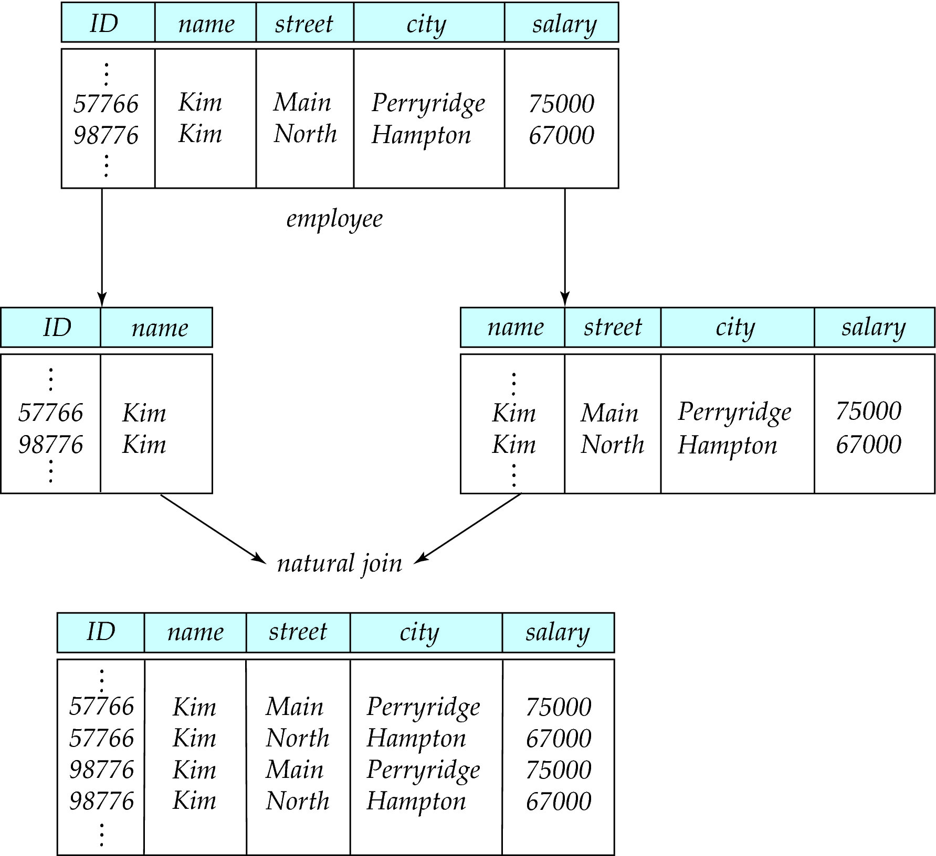
A Lossy Decomposition

Slide 38
Use of Functional Dependencies
We use functional dependencies to:
test relations to see if they are legal under a given set of functional dependencies.
If a relation r is legal under a set F of functional dependencies, we say that r satisfies F.
specify constraints on the set of legal relations
We say that F holds on R if all legal relations on R satisfy the set of functional dependencies F.
Note: A specific instance of a relation schema may satisfy a functional dependency even if the functional dependency does not hold on all legal instances.
For example, a specific instance of instructor may, by chance, satisfy name → ID.

Slide 39
Functional Dependencies (Cont.)
A functional dependency is trivial if it is satisfied by all instances of a relation
Example:
ID, name → ID
name → name
In general, α → β is trivial if β ⊆ α
Trivial FD, a FD is trivial if
A ➔ B if B is a subset of A

Slide 40
Closure of a Set of Functional Dependencies
Given a set F of functional dependencies, there are certain other functional dependencies that are logically implied by F.
For example:
If A → B and B → C, then we can infer that A → C
The set of all functional dependencies logically implied by F is the closure of F.
We denote the closure of F by F⁺.
F⁺ is a superset of F.
If A is a key so is A,B or A,B,C
Superkey concept

Slide 41
Boyce-Codd Normal Form
A relation schema R is in BCNF with respect to a set F of functional dependencies if for all functional dependencies in F⁺ of the form
α → β
where α ⊆ R and β ⊆ R, at least one of the following holds:
α → β is trivial (i.e., β ⊆ α)
α is a superkey for R
Simply said: left hand side of all FDs must be a key in all FDs
Example schema not in BCNF:
instr_dept (ID, name, salary, dept_name, building, budget )
because dept_name→ building, budget
holds on instr_dept, but dept_name is not a superkey

Slide 42
BCNF Example 1
Student {ssn, sname, address, HScode, HSname, HScity, GPA, priority}
To determine if a realtion is in BNCF we need the set ok keys/key and the set of all FDs
FDs:
SSN ➔ sName, address, GPA
GPA ➔ priority
Hscode ➔ Hsname, Hscity
Key:
{SSN,HScode}
No FD has a key on the left hand side
Not good database design

Slide 43
BCNF Example 2
Apply{ssn, cName, state, date, major}
FDs:
SSN, cName, state ➔ date, major
Each student may apply to each college only once and for only one major
Key:
{SSN, cName, state}
FD has a key on the left hand side
Good database design and in BCNF

Slide 44
Decomposing a Schema into BCNF
Suppose we have a schema R and a non-trivial dependency α →β causes a violation of BCNF.
FD that violates BCNF (left hand side is not a key)
We decompose R into:
(α U β ) - first relation
( R - ( β - α ) ) - second relation
In our example,
α = dept_name
β = building, budget
and inst_dept is replaced by
(α U β ) = ( dept_name, building, budget )
( R - ( β - α ) ) = ( ID, name, salary, dept_name )
dept_name ➔ building, budget
instr_dept (ID, name, salary, dept_name, building, budget )

Slide 45
Decompose into BCNF Algorithm
Input: relation R + FDs for R
Output: decomposition of R into BCNF relations with lossless join
Compute keys for R
Repeat until all relations are in BCNF
Pick any R` with A’ ➔ B’ that violates BCNF (FD without a key)
Decompose R’ into
R1(A,B) and R2(A, reset)
Compute FDs for R1 and R2
Compute Keys for R1 and R2
When Done R1 natural join R2 should equal to R’
R` (original relation)
 | A | B | rest
R1
 | A | B
R2
 | A | Rest

Slide 46
Decompose into BCNF Algorithm - Example
Student {SSN, sName, address, HScode, HSname, HScity, GPA, priority}
FDs (all violates BCNF)
SSN ➔ sName, address, GPA
GPA ➔ priority
HScode ➔ HSname, HScity
Lets take the last FD HScode ➔ HSname, HScity to guide our decomposition
Decomposition
S1 {HScode, HSname, HScity} - In BCNF ☺
S2 {SSN, sName, address, HScode, GPA, priority}
S2 is not in BCNF as this FD violates BCNF GPA ➔ Priority
S3 (GPA, Priority) In BCNF ☺
S4 (SSN, sName, address, HScode, GPA) - not in BCNF SSN ➔ sName, address, GPA
S5 (SSN, sName, Address, GPA) ☺ {contains attributes in the FD}
S6 (Hscode, SSN) ☺ in BCNF
Final Scheme contains S1 S3, S5 and S6
Key {SSN, HScode}

